Slide 2

He is running late.

Slide 3
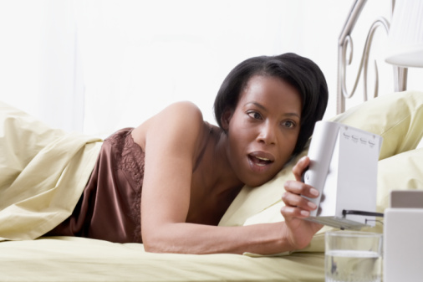
She woke up late and now she is running late for work

Slide 4
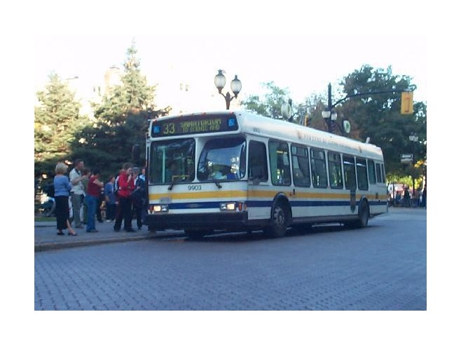
They are taking the bus.

Slide 5
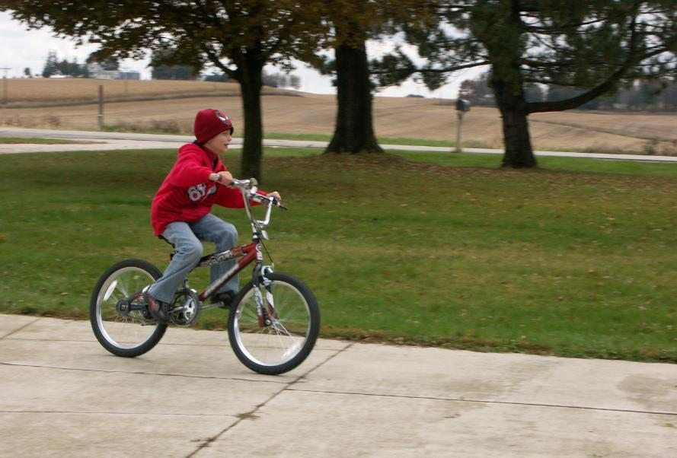
He´s riding his bike

Slide 6
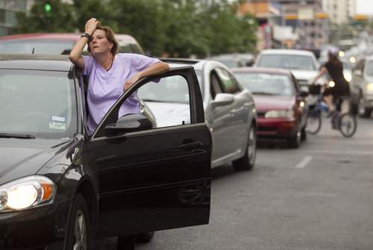
She is stuck in traffic

Slide 7
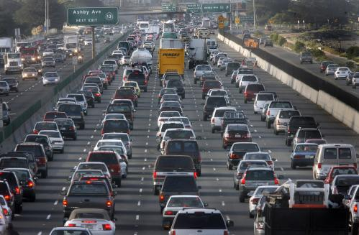
The commute in some cities can be terrible

Slide 8
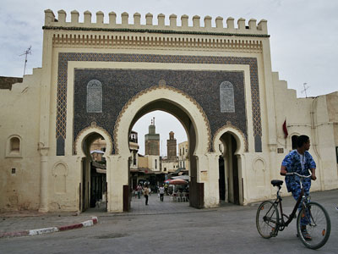
http://www.youtube.com/watch?v=T8wa9MAAUNM http://www.youtube.com/watch?v=fnKujE64J2k

